Slide 1
ChatGPT: The Task
Sam Scott, Mohawk College, May 2023

Slide 2
The Core Task of ChatGPT
Given a text prompt, predict the natural language token (word) that comes next.
ChatGPT is a Large Language Model powered by a deep Artificial Neural Network architecture called a Transformer.

Slide 3
What is a Language Model?
It’s a probability distribution for sequences of tokens (words)
“it’s my day in the sun” vs “my it’s sun day the in”
p = 90%
p = 0.1%
It can do conditional probabilities
“it’s my day in the…” → “sun”
“would you like to purchase the…” → “sun”
p = 53%
p = 5%

Slide 4
ChatGPT: One Token at a Time
 | Prompt | Output
1 | How are you today? | I

Slide 5
ChatGPT: One Token at a Time
 | Prompt | Output
1 | How are you today? | I
2 | How are you today? I | 'm

Slide 6
ChatGPT: One Token at a Time
 | Prompt | Output
1 | How are you today? | I
2 | How are you today? I | 'm
3 | How are you today? I’m | doing

Slide 7
ChatGPT: One Token at a Time
 | Prompt | Output
1 | How are you today? | I
2 | How are you today? I | 'm
3 | How are you today? I’m | doing
4 | How are you today? I’m doing | well

Slide 8
ChatGPT: One Token at a Time
 | Prompt | Output
1 | How are you today? | I
2 | How are you today? I | 'm
3 | How are you today? I’m | doing
4 | How are you today? I’m doing | well
5 | How are you today? I’m doing well | ,

Slide 9
ChatGPT: One Token at a Time
 | Prompt | Output
1 | How are you today? | I
2 | How are you today? I | 'm
3 | How are you today? I’m | doing
4 | How are you today? I’m doing | well
5 | How are you today? I’m doing well | ,
6 | How are you today? I’m doing well, | thanks

Slide 10
ChatGPT: One Token at a Time
 | Prompt | Output
1 | How are you today? | I
2 | How are you today? I | 'm
3 | How are you today? I’m | doing
4 | How are you today? I’m doing | well
5 | How are you today? I’m doing well | ,
6 | How are you today? I’m doing well, | thanks
7 | How are you today? I’m doing well, thanks | for

Slide 11
ChatGPT: One Token at a Time
 | Prompt | Output
1 | How are you today? | I
2 | How are you today? I | 'm
3 | How are you today? I’m | doing
4 | How are you today? I’m doing | well
5 | How are you today? I’m doing well | ,
6 | How are you today? I’m doing well, | thanks
7 | How are you today? I’m doing well, thanks | for
… | … | …

Slide 12
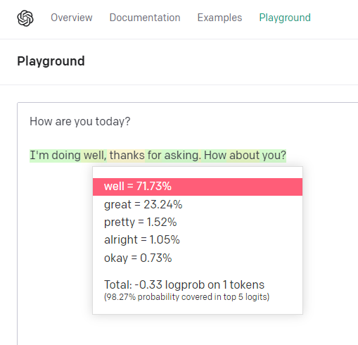
Try it Yourself!
platform.openai.com/playground
Mode: Complete
Show Probabilities: Full Spectrum
Enter a prompt
Press Submit.
Click a word…

Slide 13
A Tiny Language Model (TLM)
The TLM counts tokens (words) in a small dataset (62 MB of text)
Token | Count | Frequency (%)
. | 135 319 | 6.7%
I | 72 506 | 3.7%
the | 68 432 | 3.4%
and | 61 352 | 3.1%
that | 47 409 | 2.4%

Slide 14
TLM 1: Roulette Selection, No Context
Those optimism I it doubt getting would we and? Are but you and so the. We have that cheering the yeah administrators find that thorn change there is even all're agree what.

Slide 15
TLM 2: One Word of Context
TLM 2 Counts bigrams (pairs of tokens)
* percentage of all “the ___” bigrams
bigram | Count | Frequency*
the same | 1102 | 1.7%
the other | 1031 | 1.6%
the time | 854 | 1.3%
the way | 811 | 1.2%
the people | 709 | 1.1%

Slide 16
TLM 2: One Word Context
Prompt: I
Context: "I" …
have been to be an interesting. The one of the only the same time with them. They don't get up the time I'm going to be some of people.

Slide 17
TLM 2: One Word Context
Prompt: hello!
Context: ‘!’ …
The whole lot. The first year. The same problem. In the last two years ago the same thing. The people who had a lot of a good.

Slide 18
TLM 3: Two Word Context (trigrams)
Prompt: Tell me something interesting.
Context: 'interesting .’ …
Oh I know that's a big change. There is a little bit more. It has been the way it should be a little bit of money.

Slide 19
TLM 4: Three Word Context (4-grams)
Prompt: Tell me something interesting.
Context: 'something interesting .' ...
One possible solution is a quite radical one. Say if each household in britain was only allowed 1 car or each registered voter was allowed the volume would be immediately privileged in such a situation exhibits unfailing resolve and determination.

Slide 20
From Tiny to Large Language Models
LLMs are massively scaled up
GPT-3
570 GB (499 Billion tokens) of training text
$12 million to train
Predictions based on 2048-grams
GPT-4
Training data and costs undisclosed
Predictions based on 8192-grams or 32768-grams

Slide 21
From Tiny to Large Language Models
The TLM approach does not scale up
Storage
28 000 tokens, 350 000 bigrams, 880 000 trigrams, 1.2 million 4-grams….
How many 2048-grams?
Sparsity
The longer the sequence, the rarer it is.
“The big green” → 1 occurrence in the TLM corpus
“The big red” and “the big blue” aren’t there at all…
Large Language Models must generalize!

Slide 22
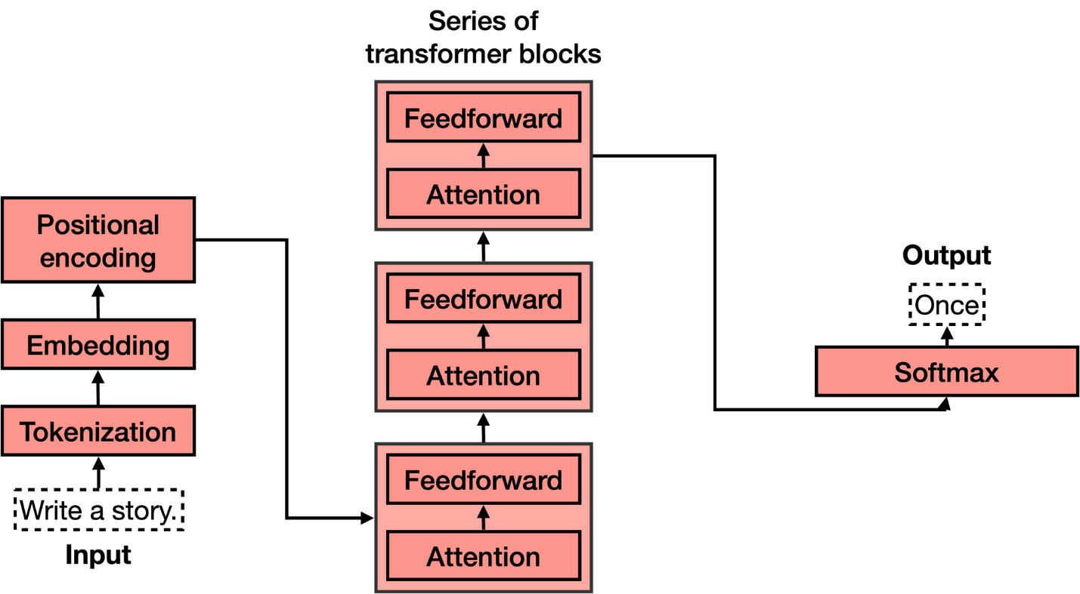
Next Video: Journey Through an LLM
Reverse Embedding
Diagram adapted from https://txt.cohere.com/what-are-transformer-models

